Slide 1
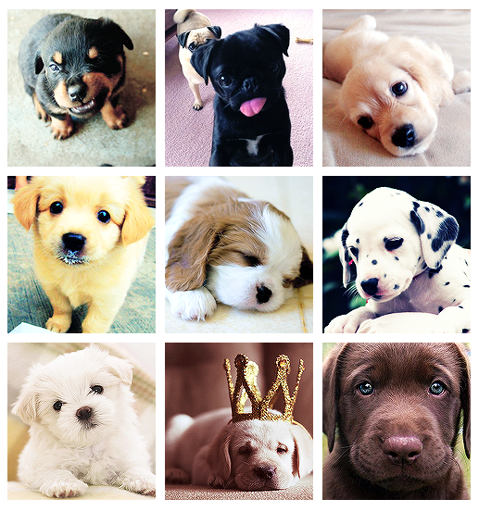
Dogs are so cute!
狗真可爱！
Gǒu zhēn kě'ài!
Can you explain why?
你能解释一下为什么吗？
Nǐ néng jiěshì yīxià wèishéme ma?
?
Notes:
Introduce myself, ask students to write name tags for themselves, do we take the roll?
Explain why I am here today. To teach a writing lesson about why dogs are so cute!
2 mins

Slide 2
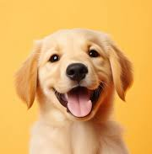
Our Writing Task Today:
Learning intention:
We are learning about foregrounding and how to use attention grabbing information to begin a paragraph.
This means:
We are learning how to use interesting and attention-grabbing words to begin a paragraph.
Success Criteria:
I can use foregrounding to write a paragraph on “Dogs are cute”.
This means:
I can use interesting describing words to write a paragraph about why dogs are cute.
我可以用有趣的描述词写一段关于为什么狗可爱的文章。
Wǒ kěyǐ yòng yǒuqù de miáoshù cí xiě yīduàn guānyú wèishéme gǒu kě'ài de wénzhāng.
Notes:
Introduce the learning intention, explain what foregrounding means.
Explain the success criteria, simplified for the class. Explain that everyone in the class has different skills in writing in English, and I will do my best to assist you with your writing today. The writing task may look different for each student today depending on their level of English skills. I am here to help you do your personal best.
3 mins

Slide 3
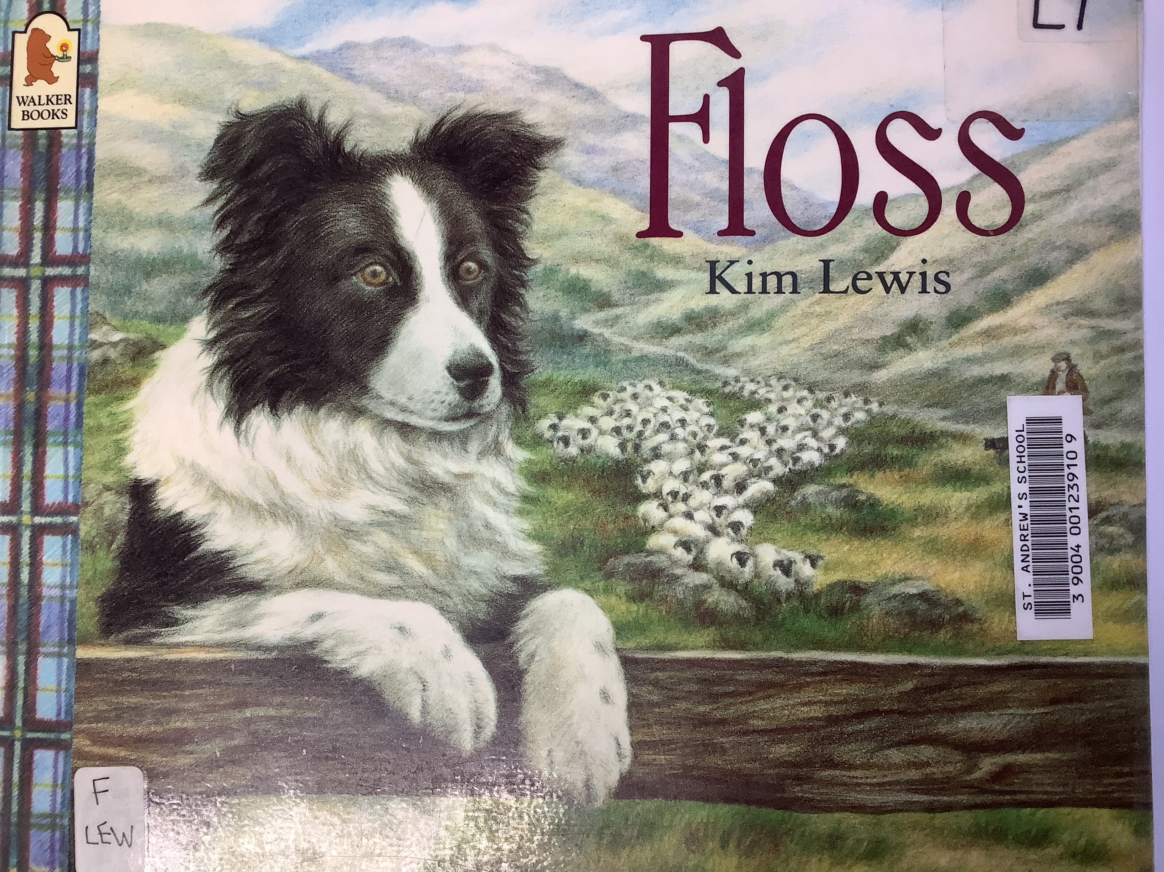
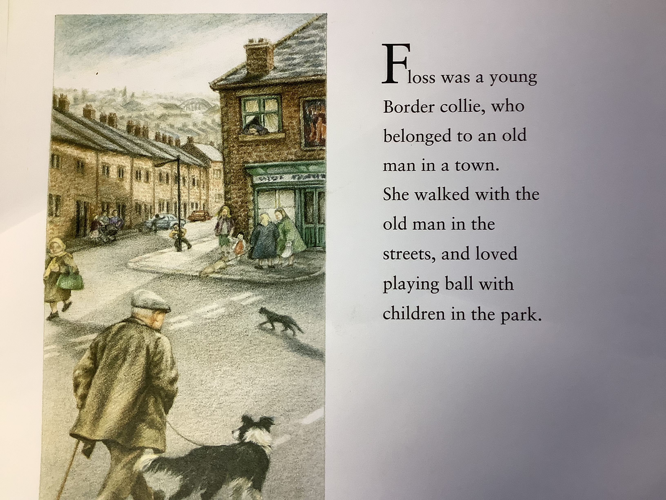
Shared Reading Example
Example of foregrounding and a paragraph about a dog named Floss.
Notes:
2 mins

Slide 4
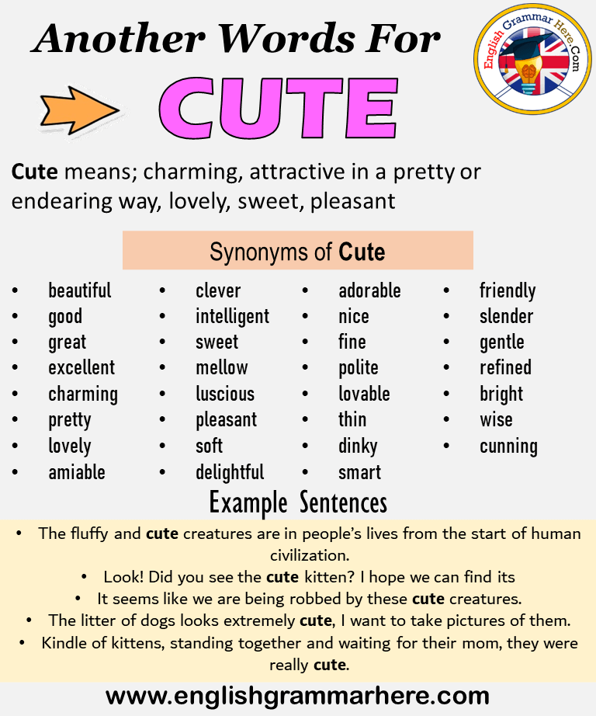
What does cute mean?
Other
Notes:
Ask the students what the word cute means? Can you use cute in a sentence? Could you change the word cute to something else? Direct to page of synonyms for cute. You may like to use some of these words in your writing today.
5 mins

Slide 5
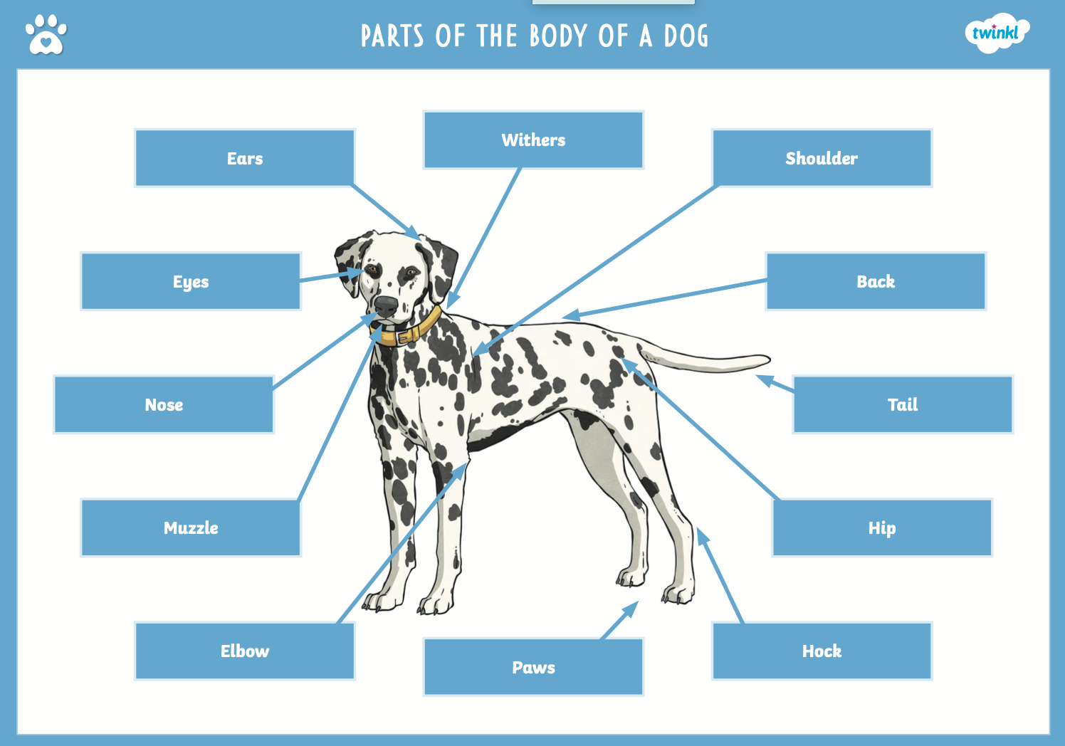
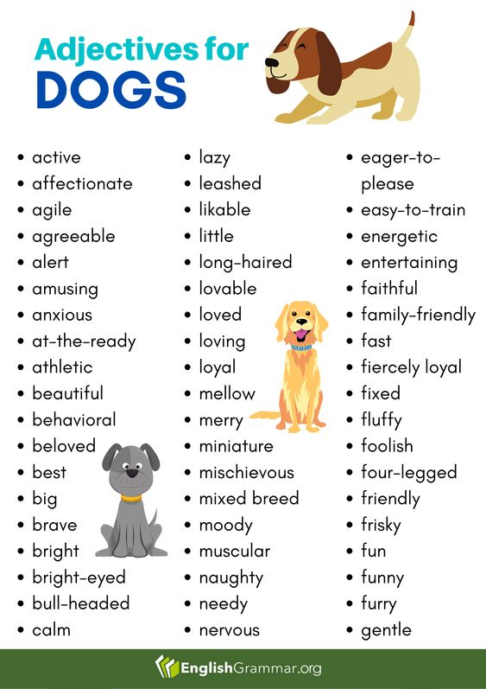
What is cute about dogs?
Behavioural Traits: How they behave.
Playful
Athletic
Clever, can follow commands
Loving
Funny
Brave
Energetic
Physical Traits: What they look like.
Eyes
Nose
Tail
Fur/ coat
Ears
Paws
Smile/ mouth/ muzzle
Notes:
Dogs can be cute for different reasons, today we are looking at the dogs physical traits and behavioural traits.
What does this mean? Can anyone explain the physical traits of dogs?
5 mins
In your booklet I have provided some words to describe physical traits and behavioural traits, these are describing words also known as adjectives.

Slide 6
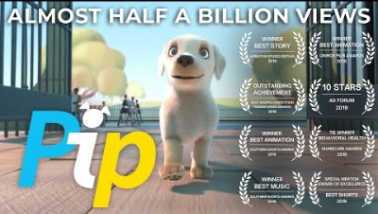
Pip the Dog: Why is Pip Cute? Think of Physically and Behaviourally.
Notes:
Now we will watch a video about a dog called Pip. Whilst watching I want you to think about why Pip is cute and try to identify something physically cute and something behaviourlaly cute. We will write about Pip together after the video. It’s only 4 minutes long.
5 mins

Slide 7
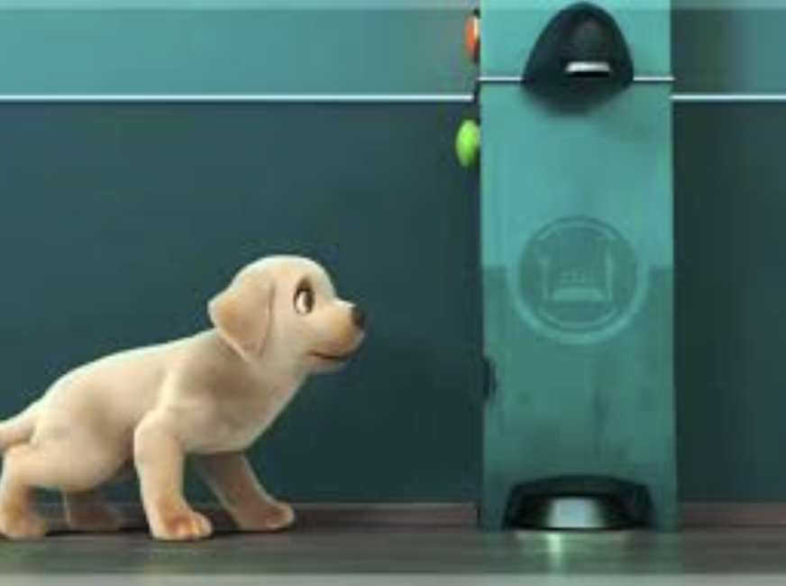
Writing Together
Why is Pip cute?
We are writing a paragraph (4-5 sentences) about Pip using describing words to explain why he is so cute.
Think of physical reasons why Pip is cute. (What Pip looks like)
Think of behavioural reasons why Pip is cute. (How Pip behaves/ acts)
Notes:
Shared Writing: Example: Ask students to suggest sentences describing Pip and why he is cute. Write suggestions on the board.
Pip is a loveable dog who is learning to be a guide dog. He has golden fur and big brown eyes. Pip is quite small but clever because he can solve problems and think quickly. He is playful but also responsible, for example, he saved a blind person’s life! Pip is the cutest dog in the whole world.
10 mins

Slide 8
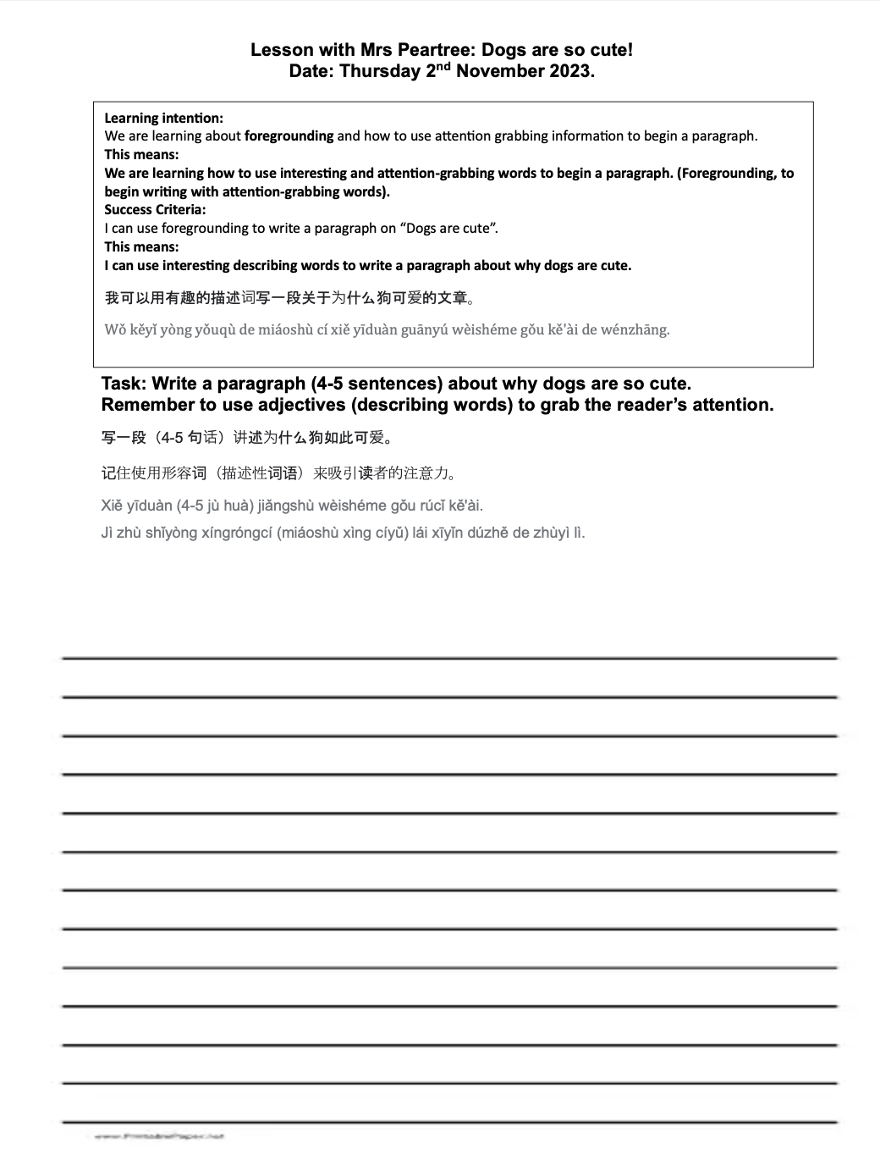
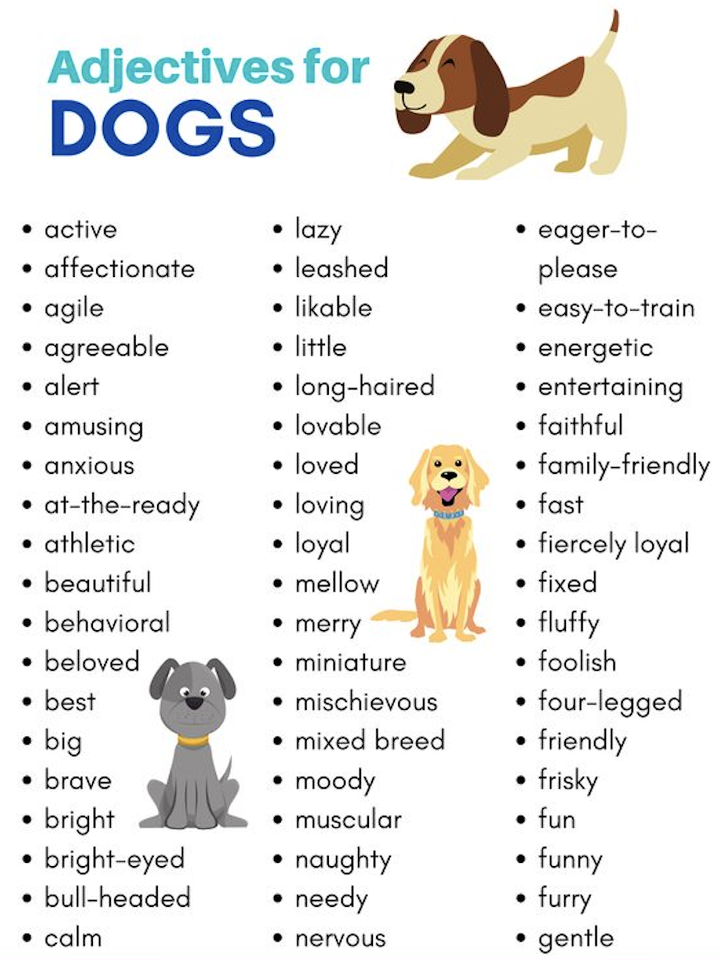
Why are dogs so cute?
1. Choose a dog to write about.
2. Remember to think of different describing words to explain why this dog is so cute.
3. Think of physical reasons.
4. Think of behavioural reasons.
5. Write one paragraph (4-5 sentences all about dogs) explaining why dogs are so cute.
Independent Writing Task:
Notes:
Explain the task, remind them this is an independent task and they should be choosing their own dogs and describing them with their own choice of words. Use the writing prompts in the booklet to assist if you need them.
Who feels confident that they could write a paragraph independently? If you feel unsure or need help please raise your hand and I will do my best to assist you. I know we have some new students here today so I’d like to check in with them first, so try your best to have a go while I’m doing this. Tell them how much time we have (15- 20 minutes) and we will be sharing our paragraphs at the end.

Slide 9
Sharing Our Writing
If you feel brave and happy to share your writing with the class please raise your hand.
If you would prefer to share your paragraph with the person next to you please raise your hand.
Some of you might prefer to show me privately, I will be looking at everyone’s work at the end of the lesson. Thank you.
Thank you for having me in your class today!
Notes:
Collect all booklets from students at the end of the lesson.
Remember to give immediate feedback about the paragraphs that were shared and throughout the writing lesson.
5 mins

