Slide 1
3 Act Task: Shark Bait!
As you complete this learning engagement, think about:
Which thinking skills are taught (explicitly or implicitly)?
--> Refer to list in PYP: Principles into Practice
How could this lesson be scaffolded to support some students thinking or extended to challenge other students thinking?
Source: Graham Fletcher (Gfletchy) 3 Act Tasks
Notes:
3 Act-Task recording sheet (PDF) available at: https://gfletchy.com/wp-content/uploads/2015/08/3-act-recording-sheet1.pdf

Slide 2
Our Learning Goals
Maths Goal
ATL Skill Goals
We are learning to estimate and find the length of an object.
Inquiry Question:
How can we use cubes to find the length of an object?
Thinking Skills
Communication Skills
Notes:
“Split Screen” for students—simplified language of the learning outcomes/standards from the curriculum documents
include familiar language & colours/icons for PYP ATL skills
Share with students before and after the learning engagement—focus on key vocabulary/concepts and skills/dispositions that will be necessary to be successful with the task
If necessary, review or explicit teaching of mathematical terminology (in blue)

Slide 3
Act 1
What do you notice?
What questions do you have?

Slide 4
How long is the worm? How can we use the cubes to find the length?
Turn & Talk
Estimate
Too low?
Too high?
What makes you say that?

Slide 5
Act 2
How long is the worm?

Slide 6
How long is the worm? How can we use the cubes to find the length?
Notes:
Discussion Question: How does he use the cubes to find the length?
Note math concepts:
measuring starts at the beginning of the object being measured
the size of the measurement unit must remain the same
measurement units are repeated with no gaps or overlaps
the measurement is the total number of units used
If students do not notice or understand any of these ideas, discuss some of the “My Favourite Mistakes” in the following slides (e.g. different sized cubes, gaps or overlaps, incorrect counting/labelling of units)

Slide 7
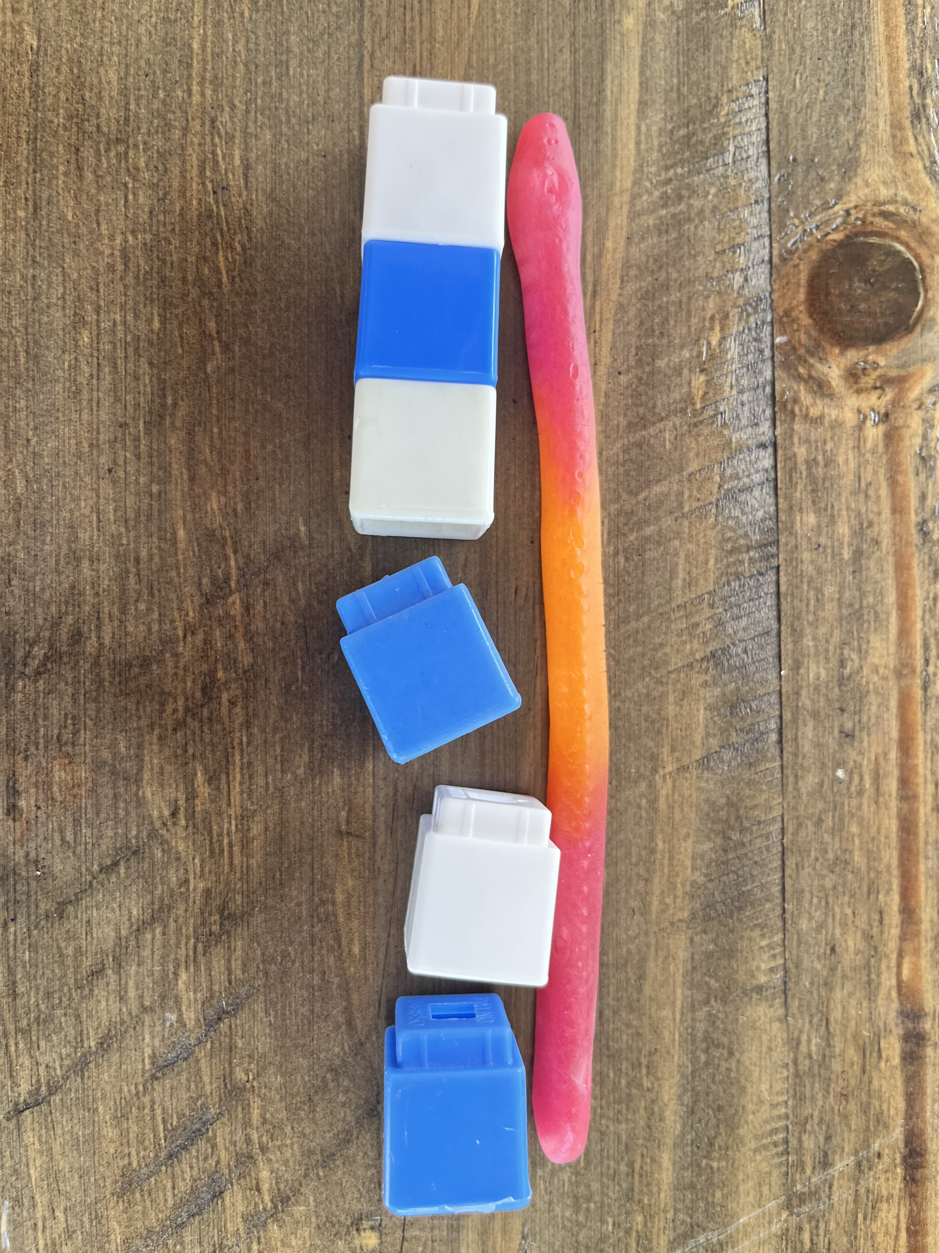
My Favourite Mistake
Sam says this worm is 6 cubes long.
Are they correct? What makes you say that?
Notes:
Discussion Question: How does he use the cubes to find the length?
Note:
measuring starts at the beginning of the object being measured
the size of the measurement unit must remain the same
MISTAKE→measurement units are repeated with no gaps or overlaps
the measurement is the total number of units used

Slide 8
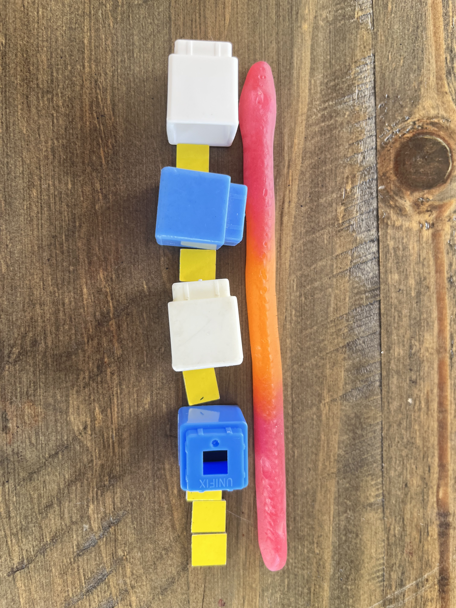
My Favourite Mistake
Taylor says this worm is 10 cubes long.
Are they correct? What makes you say that?
Notes:
Discussion Question: How does he use the cubes to find the length?
Note:
measuring starts at the beginning of the object being measured
MISTAKE→the size of the measurement unit must remain the same
measurement units are repeated with no gaps or overlaps
the measurement is the total number of units used

Slide 9
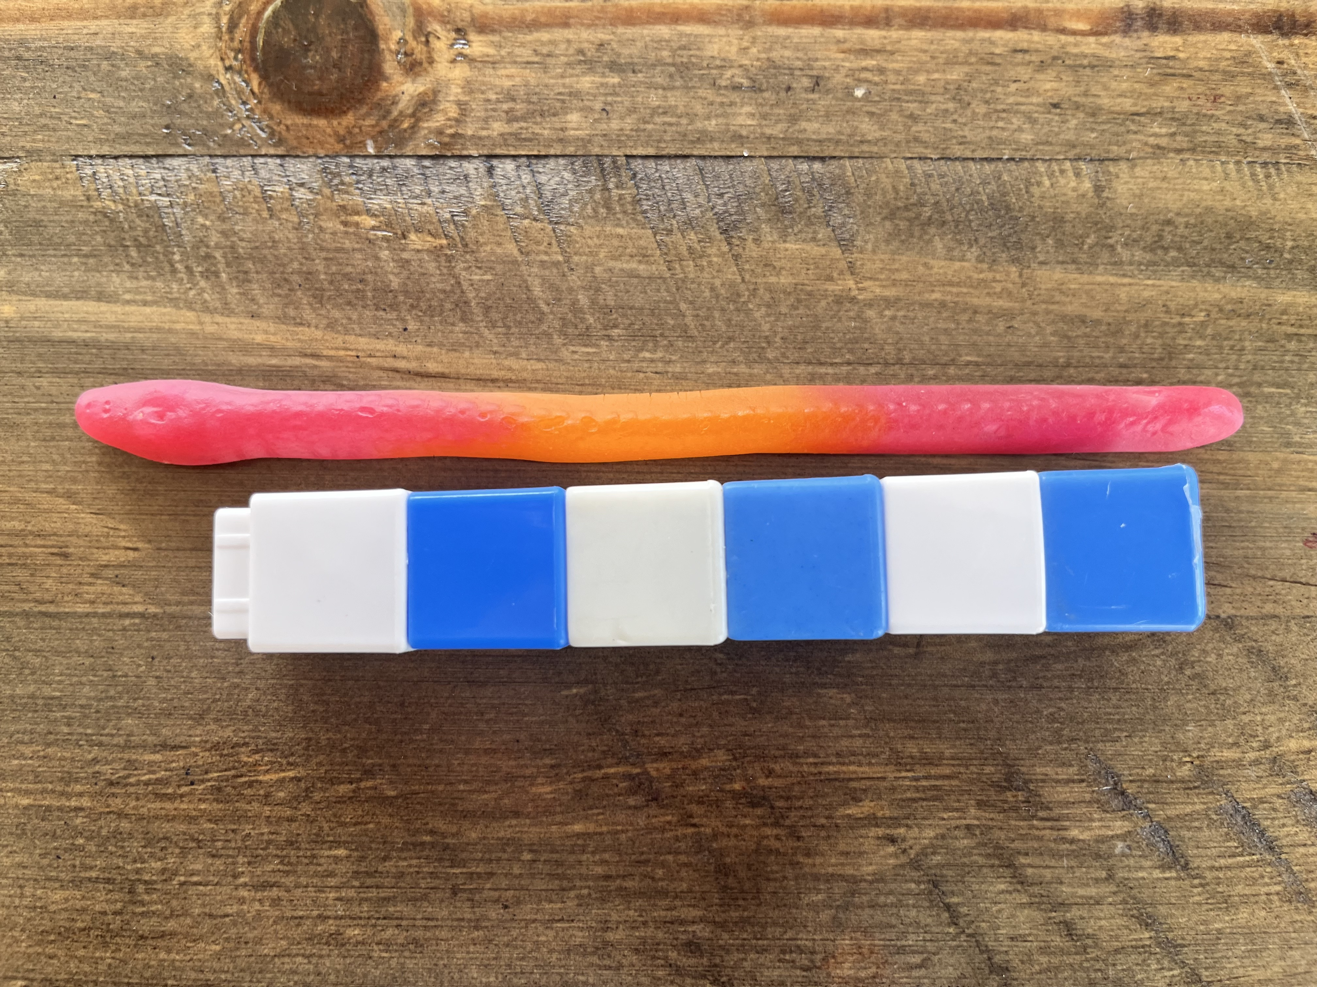
My Favourite Mistake
Jo says this worm is 6 cubes long.
Are they correct? What makes you say that?
Notes:
Discussion Question: How does he use the cubes to find the length?
Note:
MISTAKE→measuring starts at the beginning of the object being measured
the size of the measurement unit must remain the same
measurement units are repeated with no gaps or overlaps
the measurement is the total number of units used

Slide 10
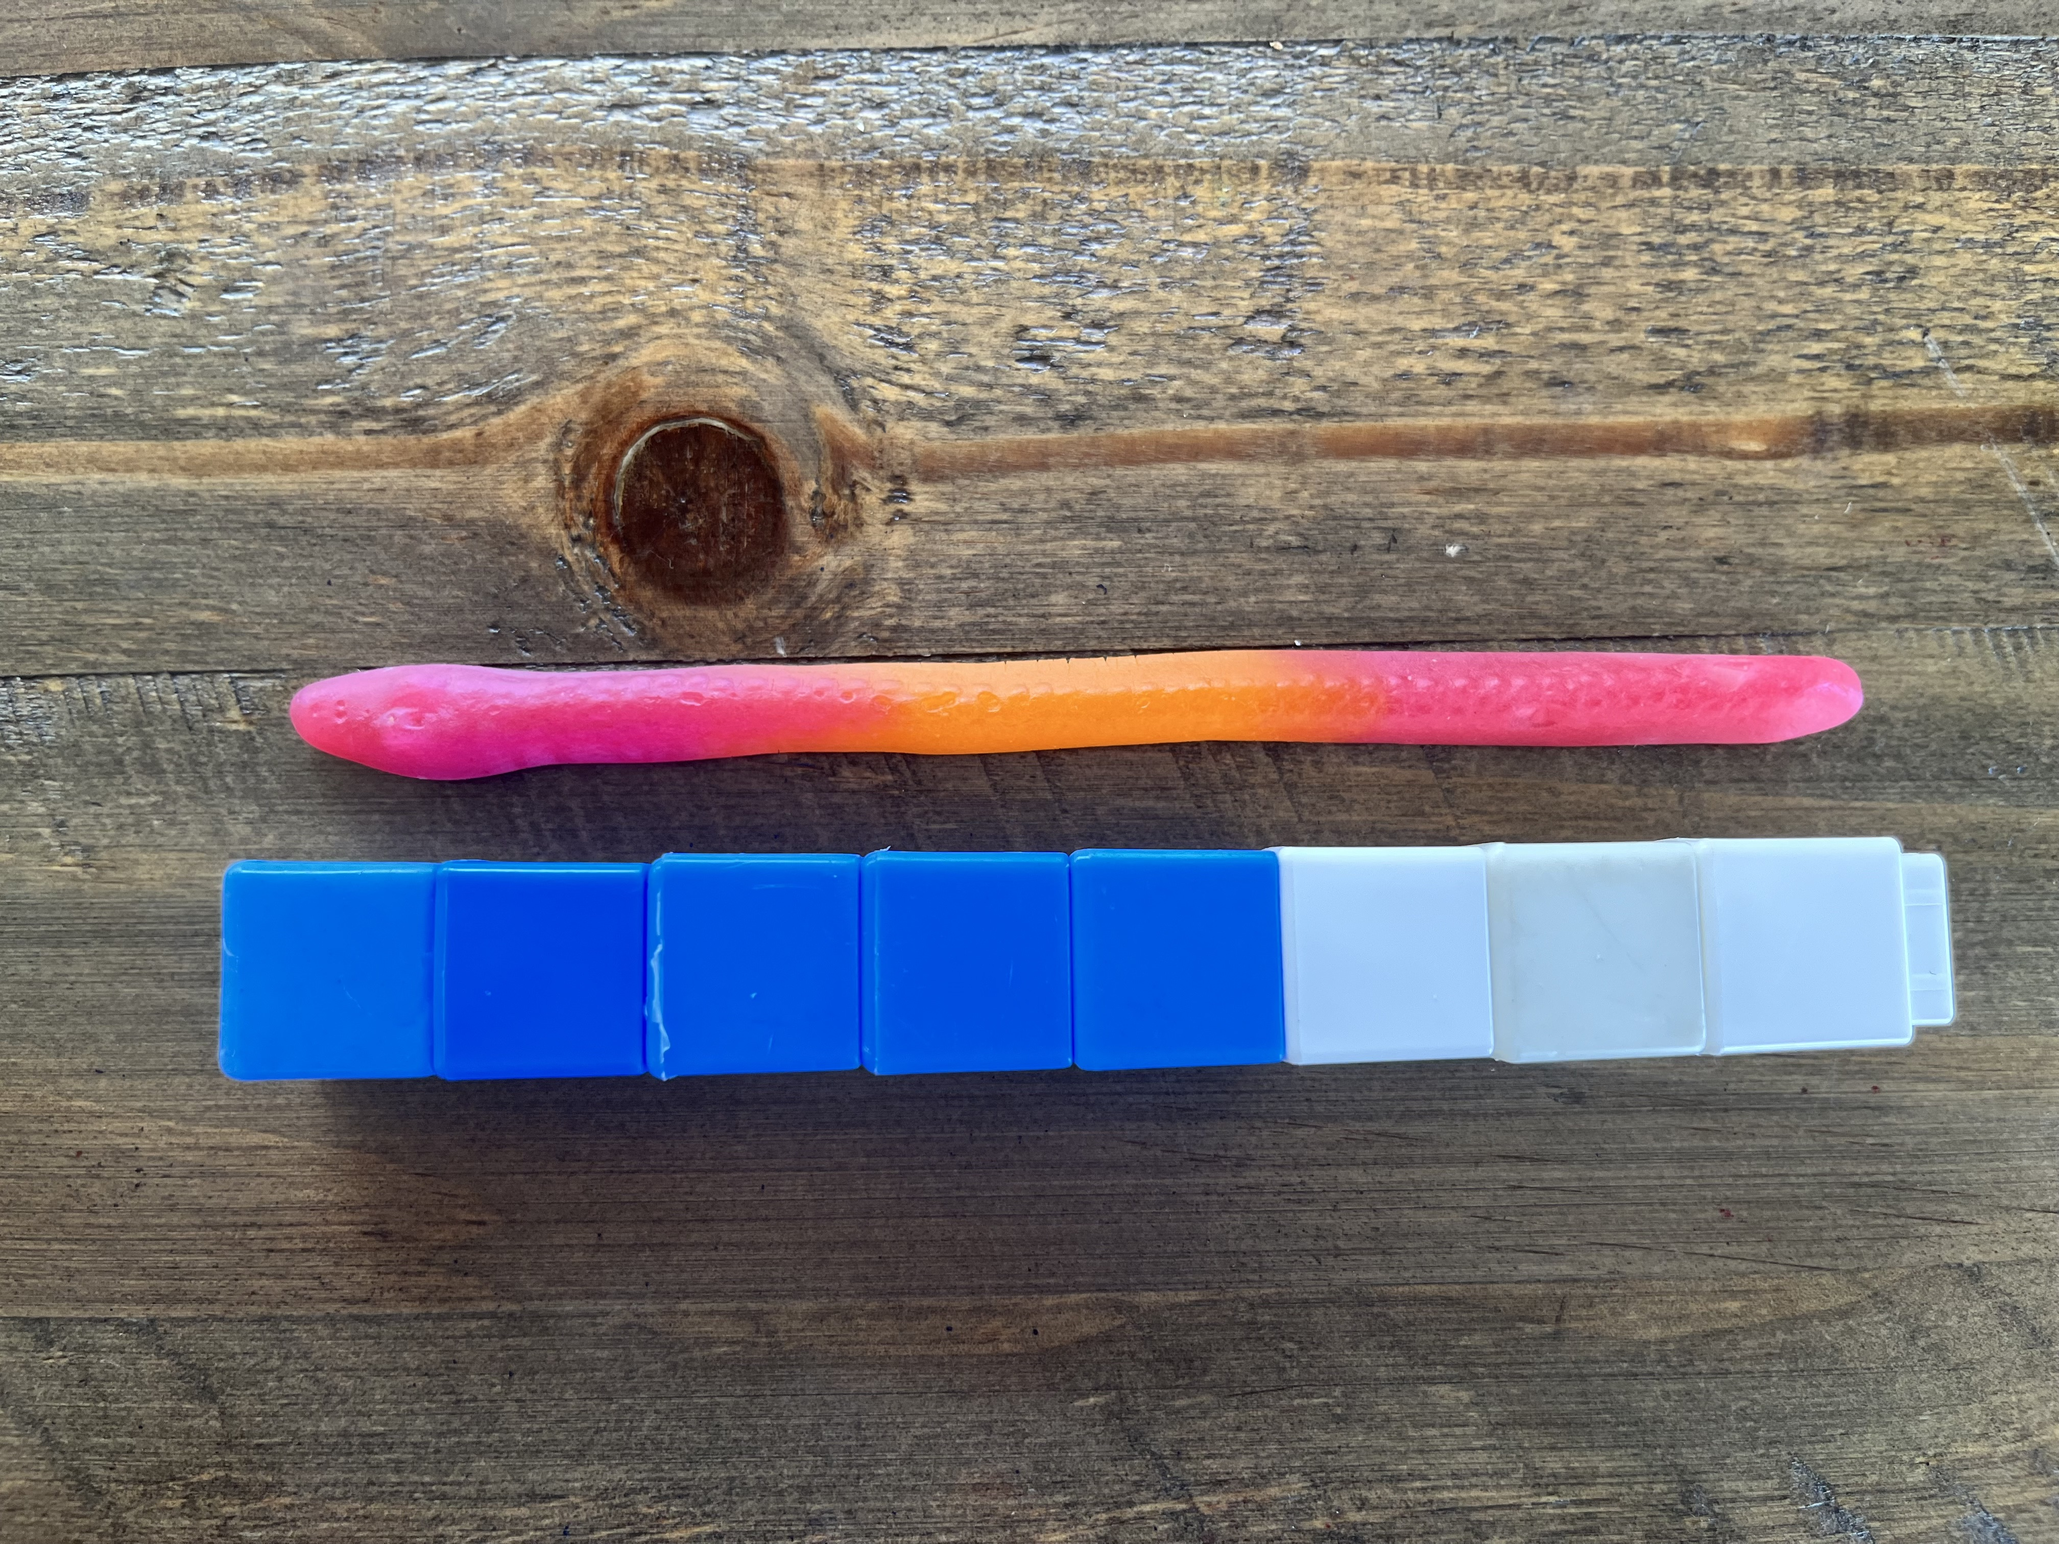
My Favourite Mistake
Vic says this worm is 8 cubes long.
Are they correct? What makes you say that?
Notes:
Discussion Question: How does he use the cubes to find the length?
Note:
measuring starts at the beginning of the object being measured
the size of the measurement unit must remain the same
measurement units are repeated with no gaps or overlaps
the measurement is the total number of units used

Slide 11
Our Learning Goals
Maths Goal
ATL Skill Goals
We are learning to estimate and find the length of an object.
Inquiry Question:
How can we use cubes to find the length of an object?
Thinking Skills
Communication Skills
Notes:
“Split Screen” for students—simplified language of the learning outcomes/standards from the curriculum documents
include familiar language & colours/icons for PYP ATL skills
Share with students before and after the learning engagement—focus on key vocabulary/concepts and skills/dispositions that will be necessary to be successful with the task
If necessary, review or explicit teaching of mathematical terminology (in blue)

Slide 12
Notes:
Did you:
Look carefully to notice important information?
Did you have ideas that you could show and explain?

Slide 13
Notes:
Did you:
Listen actively and respectfully to others’ ideas & negotiate ideas
Express yourself using words and sentences

Slide 14
Learning Intentions “Split Screen”
Mathematical Content What should students know and understand in mathematics? | Learning Skills & Dispositions What should students be able to do? How should they be able to do it?
Phase 1/Year 1 (NZ, 2023) Measurement Estimate and use a standard informal unit repeatedly to measure the length of an object (p. 9) measuring starts at the beginning of the object being measured the size of the measurement unit must remain the same measurement units are repeated with no gaps or overlaps the measurement is the total number of units used Number & Algebra recall addition facts to 20 (p. 9) group, partition, and recombine whole numbers up to 100 (p. 13) | ATL Skills in the PYP (Early Years) Thinking Skills Critical—observe carefully, organize information, test strategies or ideas Reflection—identify strengths and areas for improvement Research Skills—Information Literacy Observe and notice details Record observations Present information in a variety of modalities Communication Skills—Exchanging Information Listen actively and respectfully to others’ ideas Express oneself using words and sentences Negotiate ideas and knowledge with peers and teachers
Notes:
Example to match our Shark Bait 3 Act Task
Anything I missed?
Anything you would remove?
Note—this LE includes self-assessment component, however additional practice to consolidate skills and understanding and an additional assessment task would be used in subsequent lessons

