Slide 1
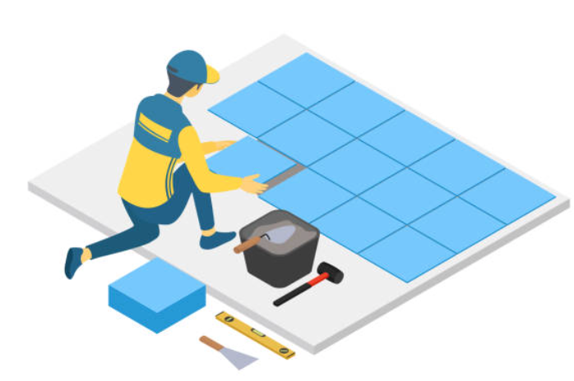
3 Act Task: Cover the Floor
As you complete this learning engagement, think about:
Which thinking skills are taught? (explicitly or implicitly)
→ Refer to list in PYP: Principles into Practice
Which maths concepts, knowledge and skills do you see in this task?
→ Match these to your written curriculum documents
How could this lesson be scaffolded to support some students thinking or extended to challenge other students thinking?
Source: Graham Fletcher (Gfletchy) 3 Act Tasks
Notes:
3 Act-Task recording sheet (PDF) available at: https://gfletchy.com/wp-content/uploads/2015/08/3-act-recording-sheet1.pdf

Slide 2
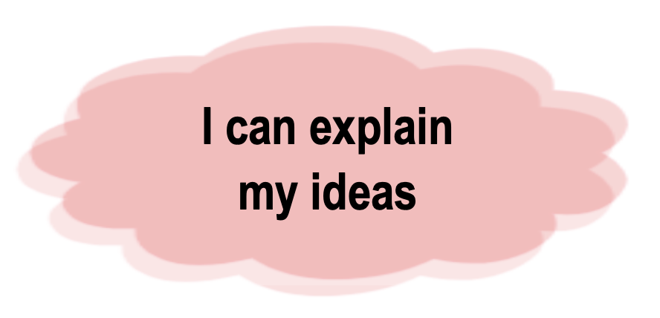
Our Learning Goals
Maths Goals
ATL Skill Goals
We are learning to find the area of rectangles.
Inquiry Question:
How can people calculate the area of a rectangle efficiently? (i.e. without counting all the units)
Thinking Skills
Research Skills
Notes:
“Split Screen” for students—simplified language of the outcomes from the curriculum documents
include familiar language, colours/icons for PYP ATL skills
Share with students before and after the learning engagement—focus on key vocabulary and concepts that will be necessary to be successful with the task
Review or explicit teaching (if necessary) of mathematical terminology in blue

Slide 3
Cover the Floor: Act 1
What did you notice?
What do you wonder?
Thinking Skills
Research Skills
Notes:
Use recording sheet: https://gfletchy.com/wp-content/uploads/2015/08/3-act-recording-sheet1.pdf

Slide 4
Main Question: How many blue squares will it take to cover the yellow rectangle?
Estimate
Too low?
Too high?
What information would you like to know to help you answer the question?
Thinking Skills
Research Skills
Notes:
Record and discuss: https://gfletchy.com/wp-content/uploads/2015/08/3-act-recording-sheet1.pdf

Slide 5
Cover the Floor: Act 2
How many squares will it take to cover the yellow rectangle?
Thinking Skills
Show your work to support your answer.
Research Skills
Notes:
A bit more information…
Record and discuss; https://gfletchy.com/wp-content/uploads/2015/08/3-act-recording-sheet1.pdf
Support—provide multi-link cubes to build and help visualize dimensions

Slide 6
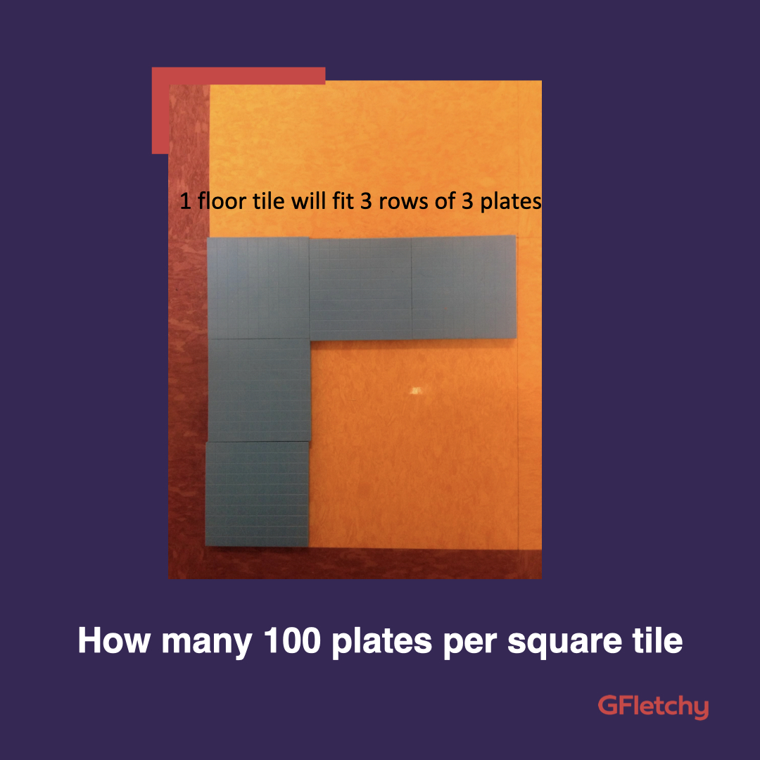
Cover the Floor: Act 2
How many squares will it take to cover the yellow rectangle?
Thinking Skills
Show your work to support your answer.
Research Skills
Notes:
A bit more information…
Record and discuss; https://gfletchy.com/wp-content/uploads/2015/08/3-act-recording-sheet1.pdf
Support—provide multi-link cubes to build and help visualize dimensions

Slide 7
Cover the Floor: Act 3
Research Skills
Show your work to support your answer.
Thinking Skills
Notes:
https://gfletchy.com/wp-content/uploads/2015/08/3-act-recording-sheet1.pdf

Slide 8
Act 4: The Sequel
Research Skills
How many blue plates would it take to cover the purple part of the floor?
How many yellow squares would it take to cover your classroom floor?
“Algebrfy” Your Mind:
Can you make a rule/formula for how many blue plates it would take to cover any room in the school?
Show your work to support your answer.
Thinking Skills
Notes:
https://gfletchy.com/wp-content/uploads/2015/08/3-act-recording-sheet1.pdf

Slide 9
Our Learning Goals
Maths Goals
ATL Skill Goals
We are learning to find the area of rectangles.
Inquiry Question:
How can people calculate the area of a rectangle efficiently? (i.e. without counting all the units)
Thinking Skills
Research Skills
Notes:
“Split Screen” for students—simplified language of the outcomes from the curriculum documents
include familiar language, colours/icons for PYP ATL skills
Share with students before and after the learning engagement—focus on key vocabulary and concepts that will be necessary to be successful with the task
Review or explicit teaching (if necessary) of mathematical terminology in blue

Slide 10
3 Act Task: Reflection and Self-Assessment
Notes:
Refer to specific learning goals (maths or ATL) to support student reflection and self-assessment

Slide 11
Learning Outcomes “Split Screen”
Mathematical Content What should students know and understand in mathematics? | Learning Skills & Dispositions What should students be able to do? How should they be able to do it?
Measurement Conceptual Understanding: Multiplication problems can involve equal groups, area, and volume. (NZ 2023, p. 14) Developing formulas allows people to calculate measurements efficiently without counting the units. (CBI Mathematics, YR 5, U3) Content Knowledge & Skills: K- Area describes a 2-dimensional surface enclosed by a boundary S- Measure area in authentic contexts S- Find the area of rectangles by counting squares (Y3) S - Use a range of procedures to measure different attributes of objects, e.g. the use of formulas for perimeter, area & volume (PYP Maths Continuum 2023, phase 4) | ATL Skills in the PYP Thinking Skills Critical—Analysis, Evaluation Transfer—Forming Decisions Reflection—Metacognition Research Skills: Information Literacy Formulating & planning Gathering & recording Synthesizing & Interpreting Evaluating & communicating
Notes:
Teacher example of “Split Screen” learning outcomes to match Cover the Floor 3 Act Task
Important Note:
”formulas” don’t appear until phase 4 in NZ curriculum
however, ”formulas” appear in phase 4 (years 4-6) of PYP Phase-based Continuum (2023)
can be explored and introduced, but do not need to assess

Slide 12
Split Screen Learning Intentions
Reflect: What are the benefits to using the “split screen” format to share the learning intentions? Think about it from the perspective of:
Teachers
Students
Families
Application: Choose a learning engagement (can be an old favourite or a new idea) and create a “split screen” of the learning intentions.
Notes:
Resources & References:
Kath Murdoch (and Guy Claxton) “The Power of Inquiry”
Thinking Pathways NZ: https://thinkingpathwayz.weebly.com/learning_intentions.html
NZ Curriculum Online: https://nzcurriculum.tki.org.nz/Archives/Media-gallery-archive/2010/Split-screen-thinking
Applying UDL Guidelines: https://teachanywhere.uvic.ca/learning-guide/udl/2-applying-udl-practices/

