Slide 1
Welcome
Date: 2024
Morning Jobs:
    Drink bottle on your spot
    Pencil case on your table
    Answer the morning question
Morning Question: Is it easy to be kind?

Slide 2
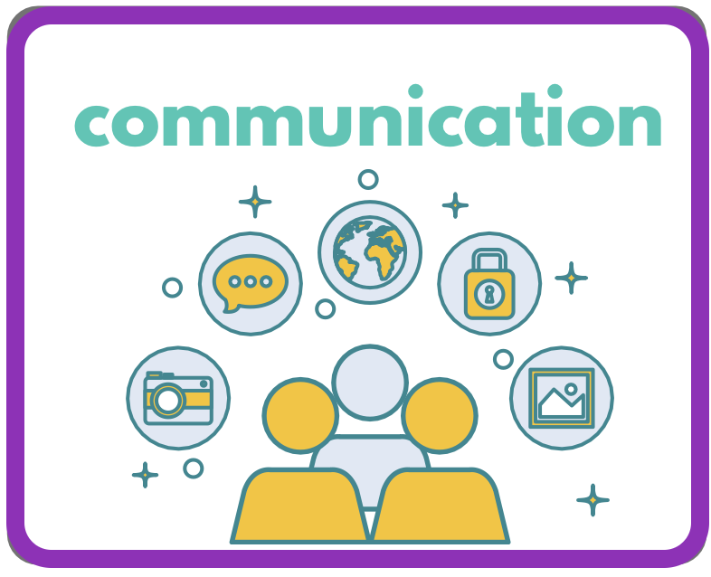
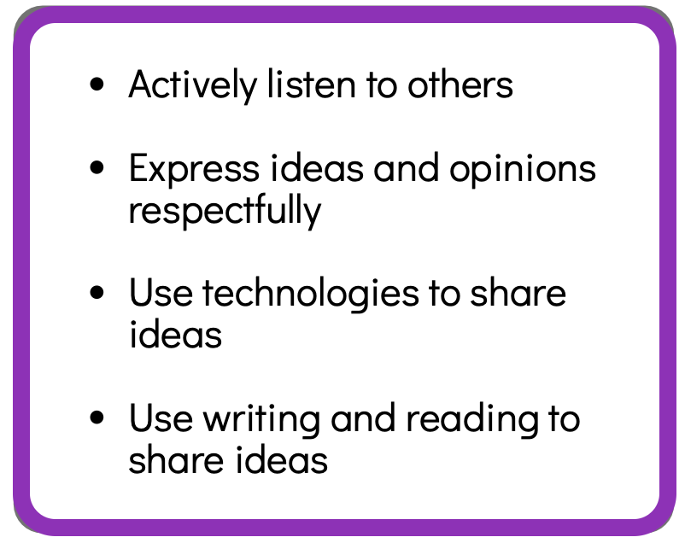
Daily Question
Is it easy to be kind?
Discussion Sentence Starters
I think… because…
I agree with ___ because…
I disagree ___ because…
I’d like to add…
I have a different opinion. I think…
I agree with what you’re say however another perspective is…
I’d like to change my answer because

